Slide 1

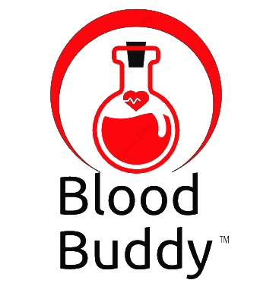
BLOOD BUDDY
Co-founders:
Sai Maneesh Reddy Kadire
Rohith Babu Ginjupalli
Venkata Suchitra Varanasi
Sai Priya Anchuri
Yaswanth Reddy Mallu

Slide 2

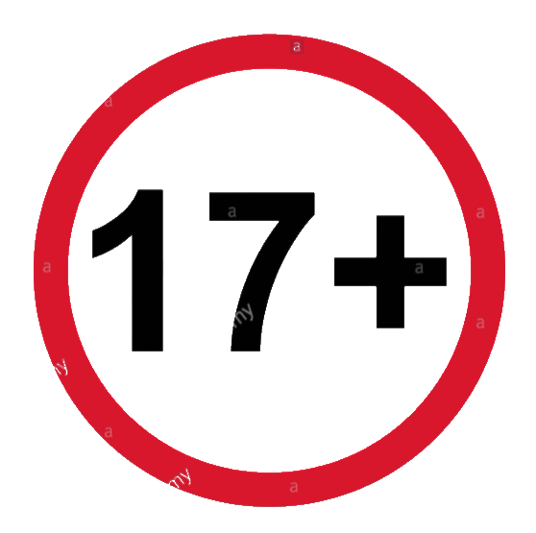
TARGET MARKET & VALUE PROPOSITIONS
Target Market:
Our app does not have any restriction on receivers or patients irrespective of age, location, income, lifestyle, gender and race.
But for donors we are targeted only for age greater than 17, because legal age to donate blood is 17.
Value Propositions:
We promise that no life will be lost due to lack of blood. And we are maintaining punctuality as our key motto.
We promise that we will contact the blood banks and trust near by, if no donor is near by the receiver location.
We promise 2 free doctor consultations for donor if donor reaches to highest rank.
Only for Donors

Slide 3


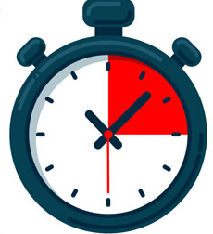
PAIN POINTS
Delay in time for finding donors.
Ineffective communications.
Blood can be stored for 42 days at 6˚C.
Complicated surgeries.
Social media assistance.
6°

Slide 4
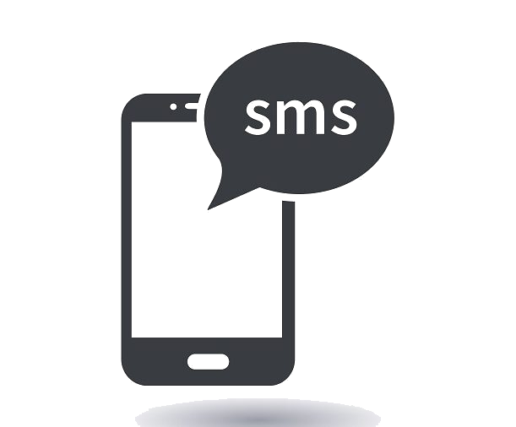

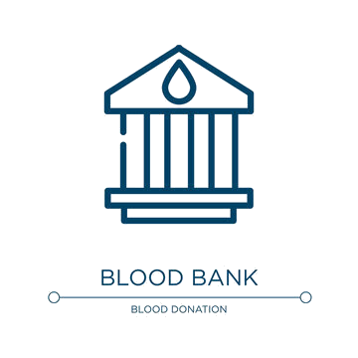
PAIN POINTS SOLUTION
Creating platform for donors and receivers/hospitals.
Blood will be on accurate time.
In emergency, guiding blood banks and trusts for help.
We filter donors based on location.

Slide 5
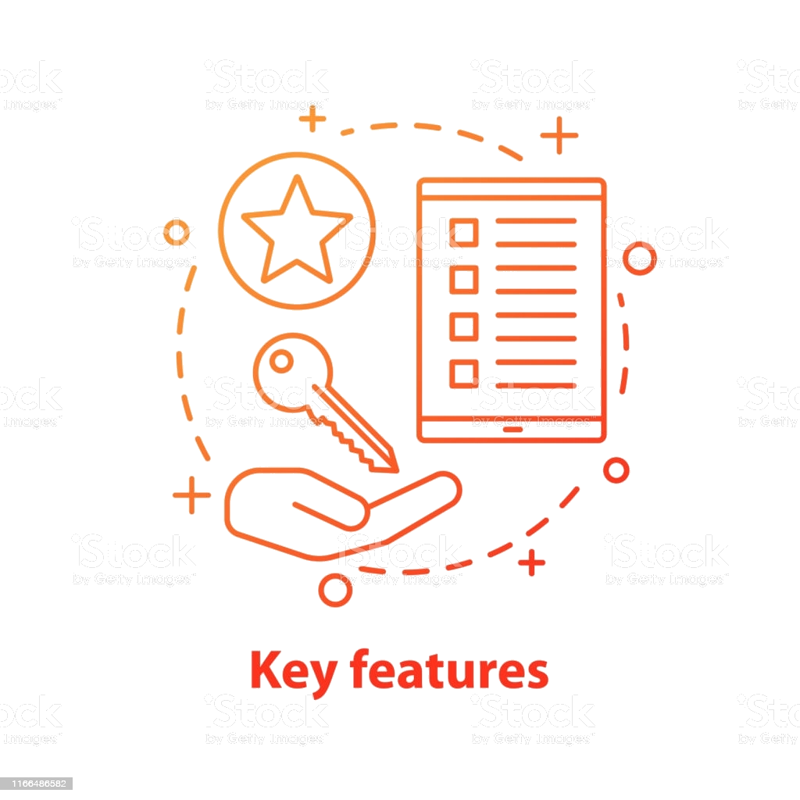

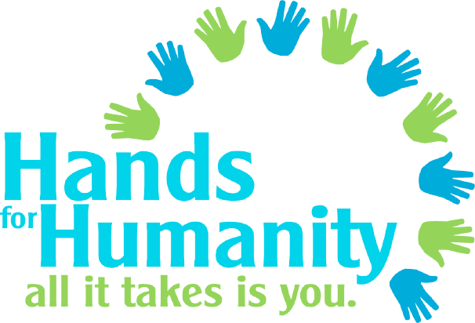
WINNING FEATURES & CAPABILITIES
Key Winning Features:
Filtering users based on Location.
Send Notifications to only donors who has similar blood group as the receiver.
When no matching donor found, our applications will send notifications to all universal donor (O+ve ).
If no response from donors and reaching to target time, app sends alerts to near by BLOOD BANK.
Capabilities:
For humanity. (totally and absolutely no cost)
Alerts monitoring.
Notifications.
Easy communication with donors.

Slide 6
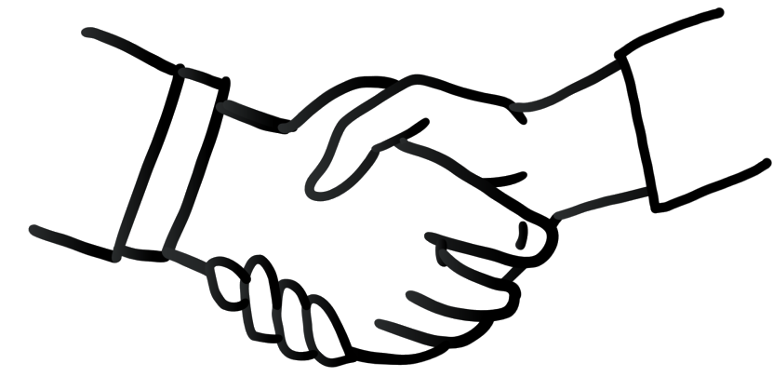
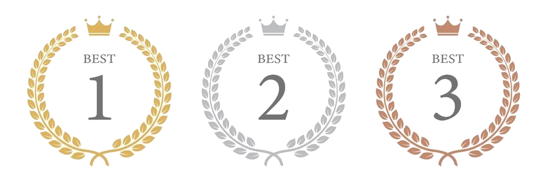
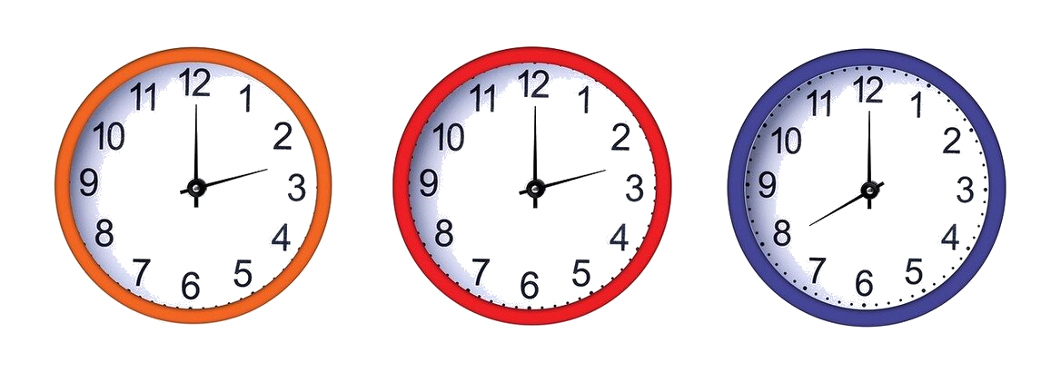
JUSTIFICATION
Justification:
No LOSS OF LIFE due to
Improper communications which leads to late response.
Connecting donors on a single platform whenever there is an emergency.
Maintained different time phases, each phase gets triggered based on previous results.
Encourage donors with different scenarios like free doctor consultation for highest rankers.

Slide 7
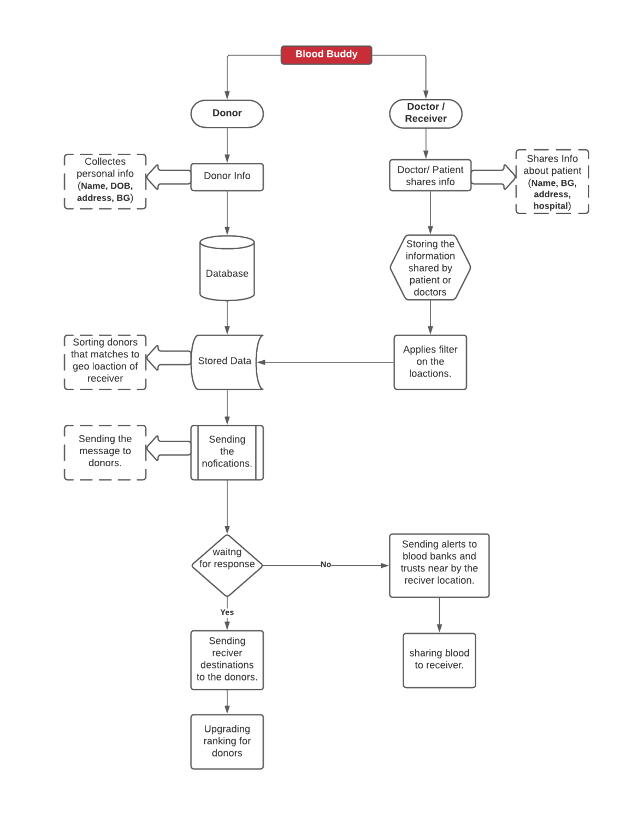
CURRENT STATUS & YOUR PROTOTYPE
Important Logic
select * from donor_info (where blood_group = '"+blood+"' and donor_latitude <= " + lat_max+" and donor_latitude >= " + lat_min +" and donor_longitude >= "+ long_min+" and donor_longitude <= "+long_max)
Important Calculation:
1° Longitude = 54.6 Miles
1° Latitude = 69 Miles
Gathering blood bank info near by locations to complete our application

Slide 8

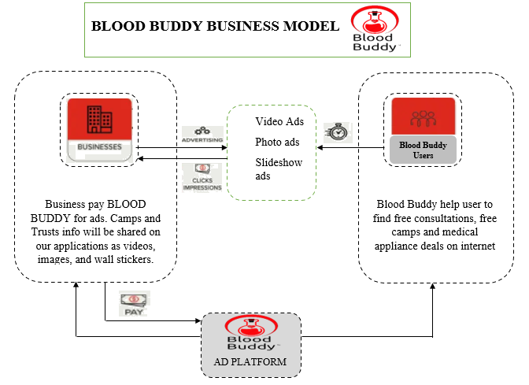
BUSINESS CYCLE & Making Money
Planning
Operations & Maintenance
Requirements
Deployment
Design & PROTOTYPING
Testing
Software Development
Our Applications is web-based applications.
It is made publicly accessible.
Making money by advertising and promotions, in particular medical appliances and blood donations camps and trusts.
And sharing our insights and revealing our future project which is extension of Blood donor app i.e., Organ Donor.

Slide 9
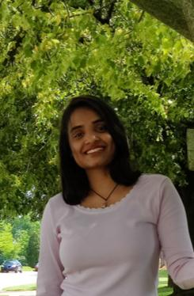
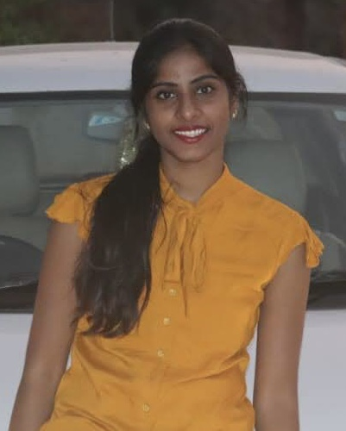
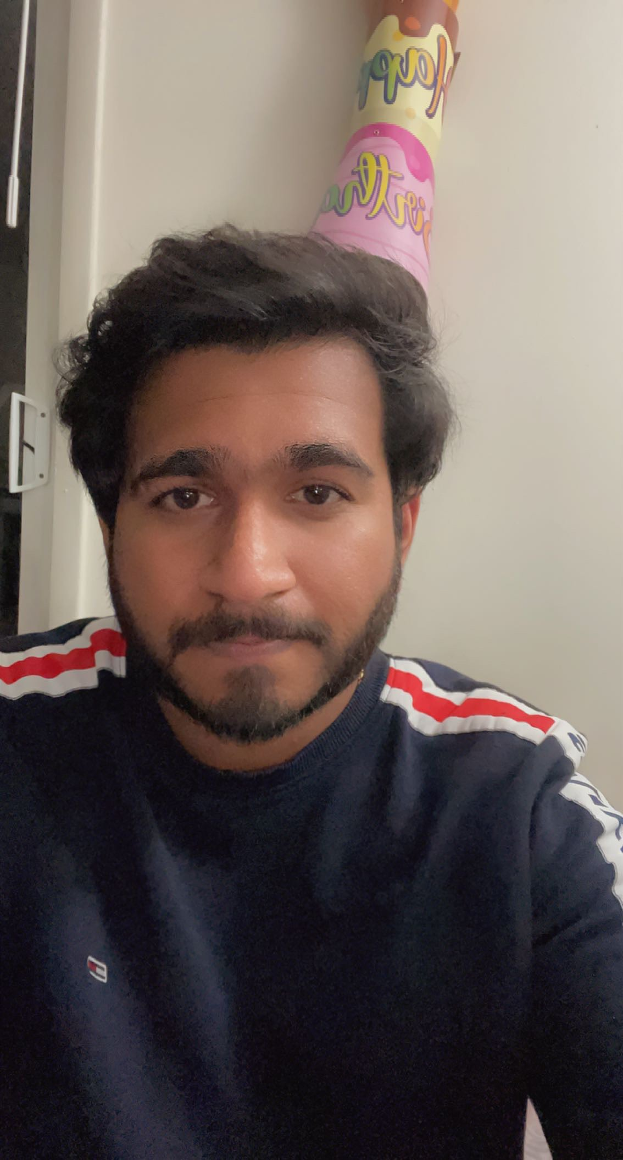
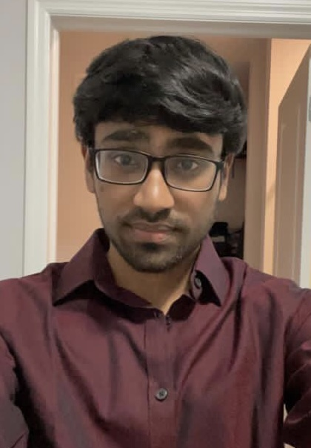
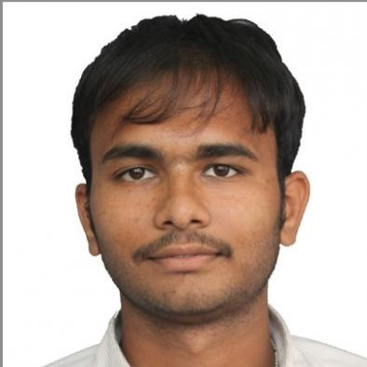
TEAM MEMBER & CONTRIBUTIONS
Manish Reddy -- Architecture & Backend using Java.
Rohith Babu -- Idea & Architecture.
Suchitra – UI & Presentation.
Sai Priya – Framework & Testing
Yaswanth – Database & Admin
We named our team as DC Dynamites.
Everyone in team have working experience which helps team to solve real time scenarios.
Our main motto is grow together, everyone in team motivate each other and share information being collaborative.

Slide 10
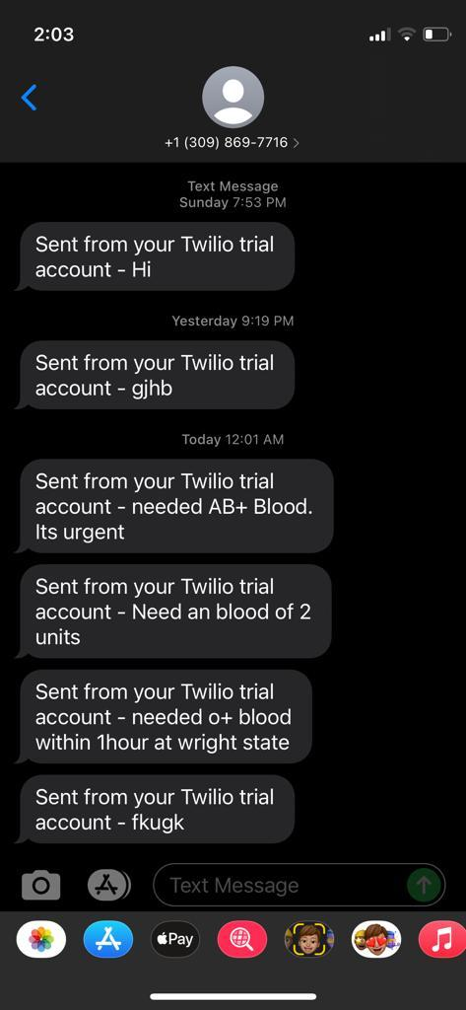
TECHNICAL-VALIDATION
Market Entry
Our Applications is so unique that no other app has matched it till date.
Mainly we success in the market because of the timely mannered and location-based notification
We provide our app completely free where we can gain a lot of positiveness.
Technical Validation:
After successful local run of our application, we confirm our design stage has been completed.
Here I am attaching our screenshots of notification that sent by our applications with matched blood groups.

Slide 11
THANK YOU
From
DC DYNAMITES

